Slide 1
ISO27001:2013 Controls Appendix; Part 1
Lets have a look at the ISO27001:2013 (ISMS) controls (appendix) in more detail

Slide 2

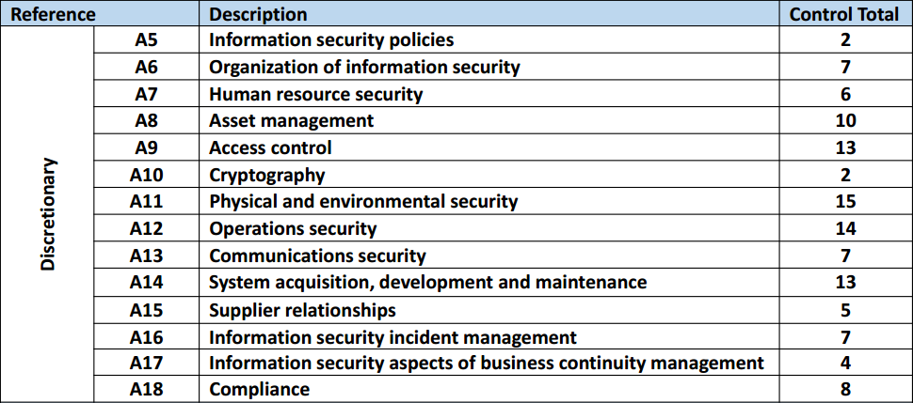
ISO27001:2013 Controls Appendix; Part 1
TOTAL: 114
ISO27001:2013 DISCRETIONARY CONTROLS
https://chapters.theiia.org/bermuda/Events/ChapterDocuments/Information%20Security%20Management%20System%20%28ISMS%29%20Overview.pdf

Slide 3
ISO27001:2013 Controls Appendix; Part 1
A.5 INFORMATION SECURITY POLICIES
A.5.1 MANAGEMENT DIRECTION FOR INFORMATION SECURITY
Objective: To provide management direction and support for information security in accordance with business requirements and relevant laws and regulations.
A.5.1.1 | POLICIES FOR INFORMATION SECURITY | Control: A set of policies for information security shall be defined, approved by management, published and communicated to employees and relevant external parties.
A.5.1.2 | REVIEW OF THE POLICIES FOR INFORMATION SECURITY | Control: The policies for information security shall be reviewed at planned intervals or if significant changes occur to ensure their continuing suitability, adequacy and effectiveness.

Slide 4
ISO27001:2013 Controls Appendix; Part 1
A.6 ORGANIZATION OF INFORMATION SECURITY
A.6.1 INTERNAL ORGANIZATION
Objective: To establish a management framework to initiate and control the implementation and operation of information security within the organization.
A.6.1.1 | INFOSEC ROLES & RESPONSIBILITIES | Control: All information security responsibilities shall be defined and allocated.
A.6.1.2 | SEGREGATION OF DUTIES | Control: Conflicting duties and areas of responsibility shall be segregated to reduce opportunities for unauthorized or unintentional modification or misuse of the organization’s assets.

Slide 5
ISO27001:2013 Controls Appendix; Part 1
A.6 ORGANIZATION OF INFORMATION SECURITY
A.6.1 INTERNAL ORGANIZATION
A.6.1.1 | INFOSEC ROLES & RESPONSIBILITIES
A.6.1.2 | SEGREGATION OF DUTIES
A.6.1.3 | CONTACT WITH AUTHORITIES
A.6.1.4 | CONTACT WITH SPECIAL INTEREST GROUPS
A.6.1.5 | INFORMATION SECURITY IN PROJECT MNGMT

Slide 6
ISO27001:2013 Controls Appendix; Part 1
A.6 ORGANIZATION OF INFORMATION SECURITY
A.6.1.3 | CONTACT WITH AUTHORITIES | Control: Appropriate contacts with relevant authorities shall be maintained
A.6.1.4 | CONTACT WITH SPECIAL INTEREST GROUPS | Control: Appropriate contacts with special interest groups or other specialist security forums and professional associations shall be maintained.

Slide 7
ISO27001:2013 Controls Appendix; Part 1
A.6 ORGANIZATION OF INFORMATION SECURITY
A.6.2 MOBILE DEVICES & TELEWORKING
A.6.2.1 | MOBILE DEVICE POLICY
A.6.2.2 | TELEWORKING
A.6.2.2 | TELEWORKING | Control: A policy and supporting security measures shall be implemented to protect information accessed, processed or stored at teleworking sites.

Slide 8
ISO27001:2013 Controls Appendix; Part 1
Gradually you will develop the skill to use the ISO27001:2013 standard quickly and with ease for your benefit…
END

